Slide 1
CAS Applied Data Science Module 3 - Data Analysis and Machine Learning
Aref Hosseini
11th of Nov. 2024

Slide 2

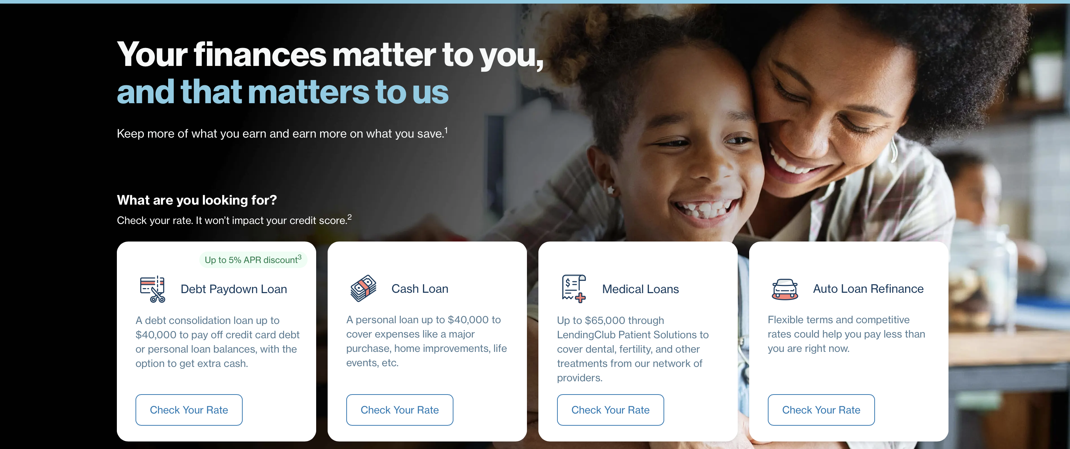
Data source:
https://www.lendingclub.com
Data from 2007 - 2010
Notes:
Lending Club connects people who need money (borrowers) with people who have money (investors). Hopefully, as an investor you would want to invest in people who showed a profile of having a high probability of paying you back. We will try to create a model that will help predict this.

Slide 3
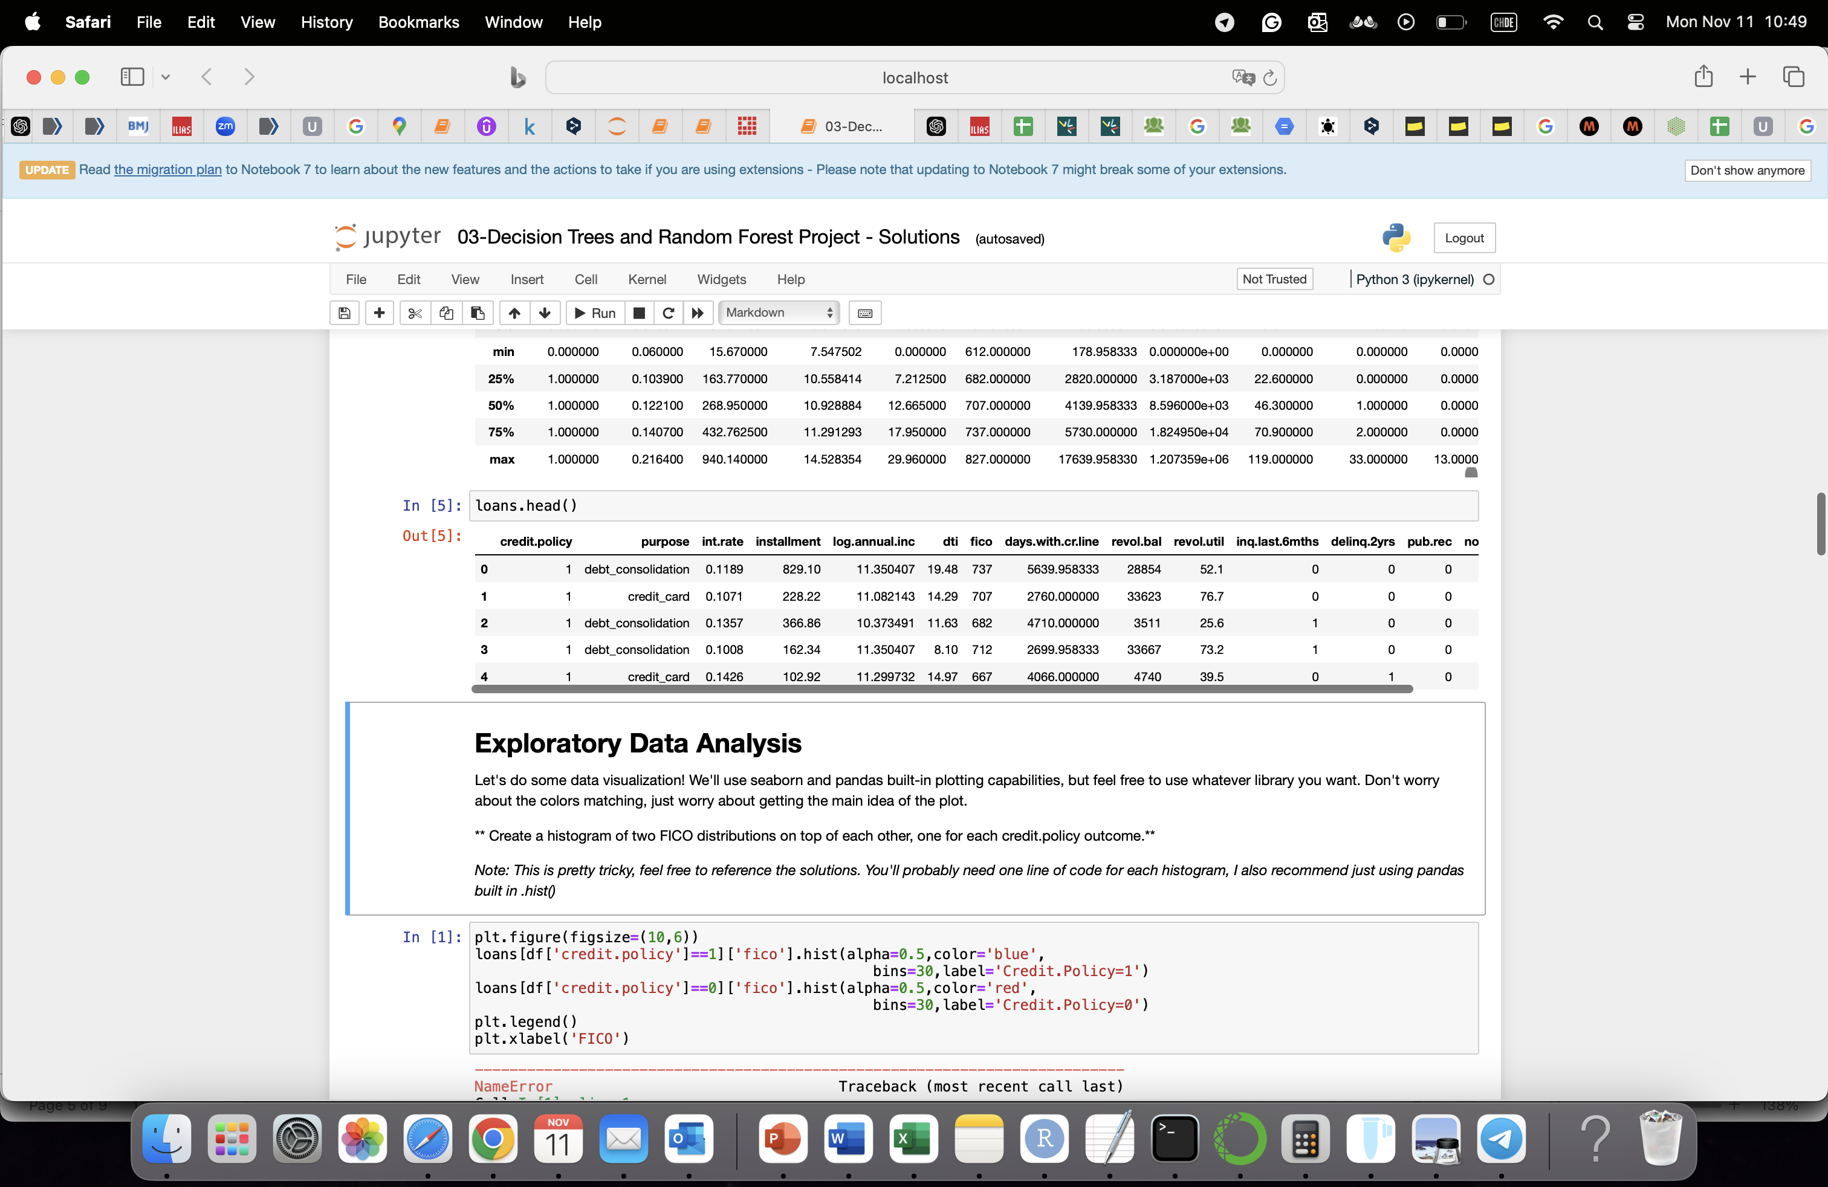
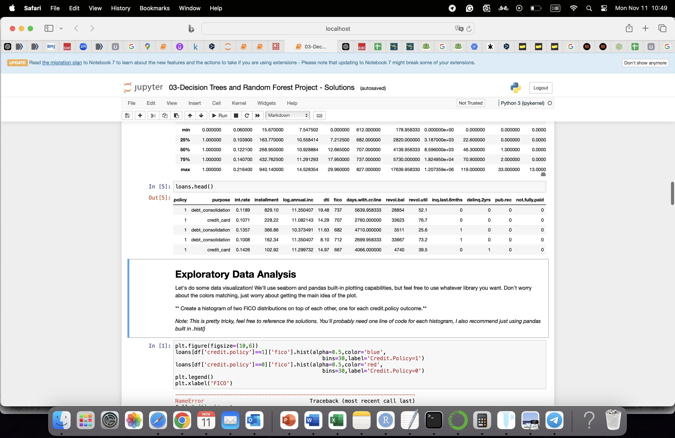
Data:
credit.policy: Shows if a customer meets LendingClub's criteria for a loan. "1" means they meet the criteria; "0" means they don’t.
purpose: Tells why the customer wants the loan. Categories include things like "credit card," "debt consolidation," "education," "big purchases," "small business," and "other.”
int.rate: The interest rate on the loan. It’s shown as a decimal, so 0.11 means an 11% interest rate. Higher rates are given to customers considered riskier.
fico: The borrower’s FICO credit score, which is a measure of their creditworthiness. Depends on several factor: Payment history, Amount of debt, Length of credit history, etc.
Notes:
The FICO credit score is a numerical rating that lenders use to evaluate a person's creditworthiness, or how likely they are to repay loans on time. It ranges from 300 to 850, with higher scores indicating better creditworthiness.
The FICO score considers several factors:
Payment history (whether past bills were paid on time),
Amount of debt (how much of the available credit is in use),
Length of credit history (how long accounts have been open),
New credit inquiries (recent applications for credit),
Credit mix (types of credit like credit cards, loans).
Lenders use FICO scores to decide whether to approve loans and set interest rates, as it predicts how likely a borrower is to default on payments.
credit.policy: Shows if a customer meets LendingClub's criteria for a loan. "1" means they meet the criteria; "0" means they don’t.
purpose: Tells why the customer wants the loan. Categories include things like "credit card," "debt consolidation," "education," "big purchases," "small business," and "other."
int.rate: The interest rate on the loan. It’s shown as a decimal, so 0.11 means an 11% interest rate. Higher rates are given to customers considered riskier.
installment: The monthly amount the borrower needs to pay back if they get the loan.
log.annual.inc: The log-transformed annual income reported by the borrower. This is used to make income comparisons easier.
dti: Stands for "debt-to-income ratio." This is the borrower’s debt divided by their annual income, indicating how much of their income goes toward paying debts.
fico: The borrower’s FICO credit score, which is a measure of their creditworthiness.
days.with.cr.line: How long (in days) the borrower has had access to credit (credit card, line of credit, etc.).
revol.bal: The balance still owed on the borrower’s credit cards or similar credit lines at the end of each billing period.
revol.util: The percentage of the borrower’s credit line they’re using. For example, if they’re using half of their available credit, this would be 50%.
inq.last.6mths: The number of times creditors have checked the borrower’s credit in the last 6 months (often happens when they apply for new credit).
delinq.2yrs: The number of times in the past 2 years that the borrower was more than 30 days late on a payment.
pub.rec: The number of public records of negative credit events, like bankruptcies or tax liens, in the borrower’s history.

Slide 4
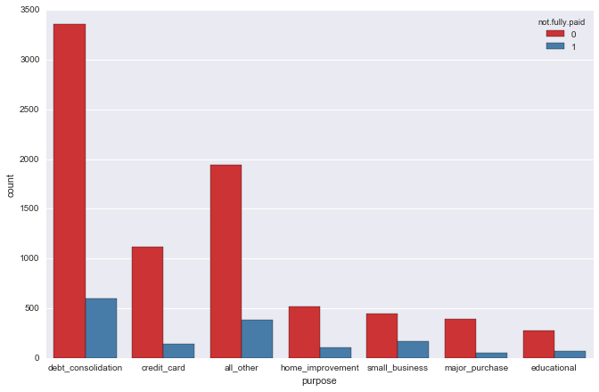
Exploratory Data Analysis:

Slide 5
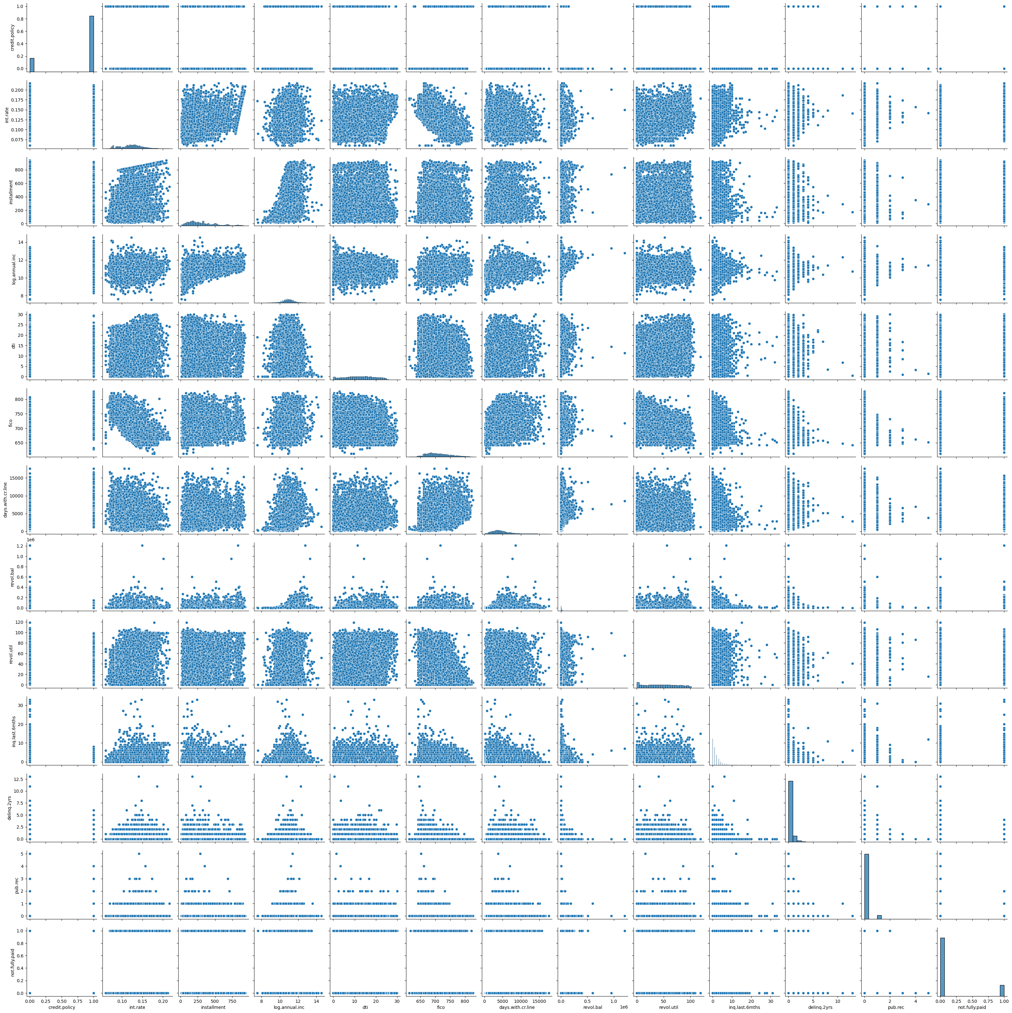
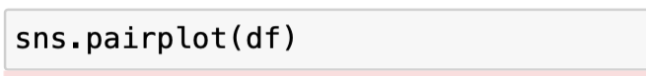
Exploratory Data Analysis:

Slide 6
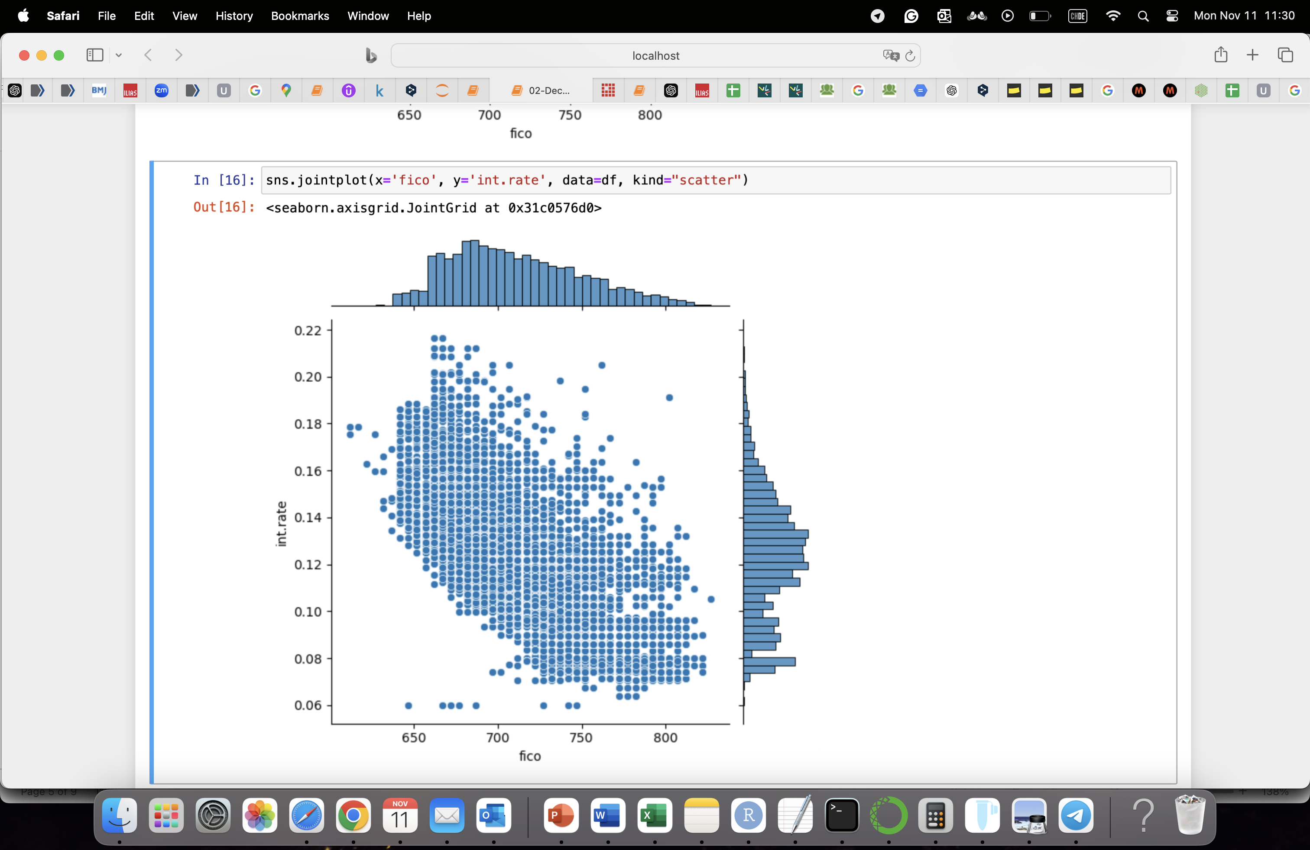
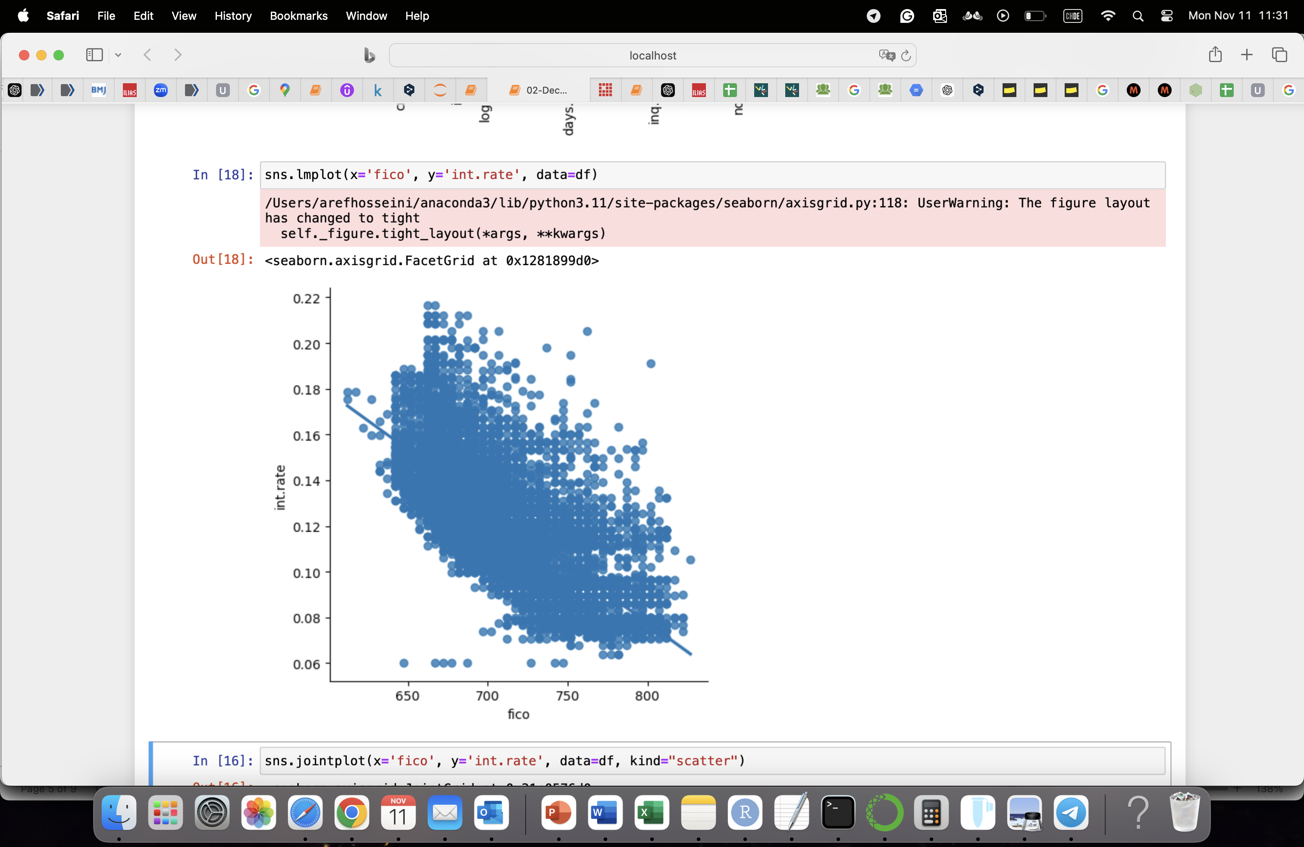
Exploratory Data Analysis:

Slide 7
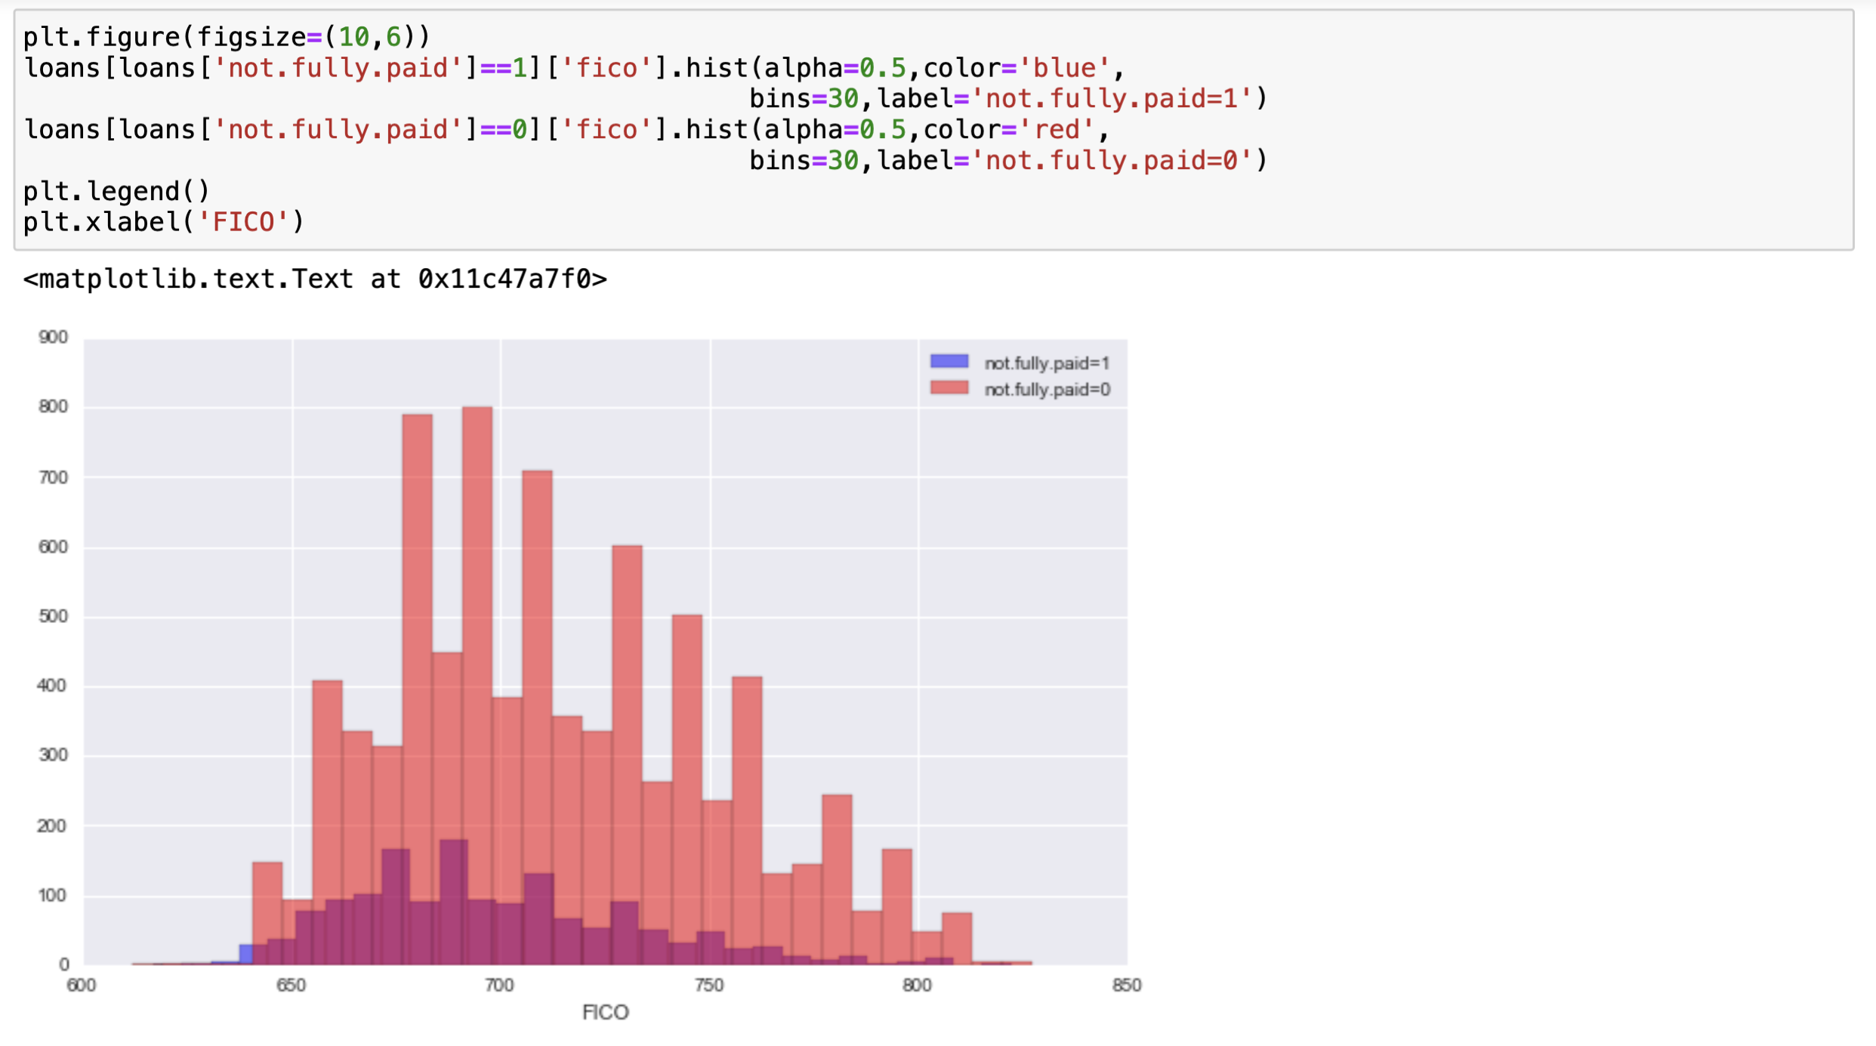
Exploratory Data Analysis:

Slide 8
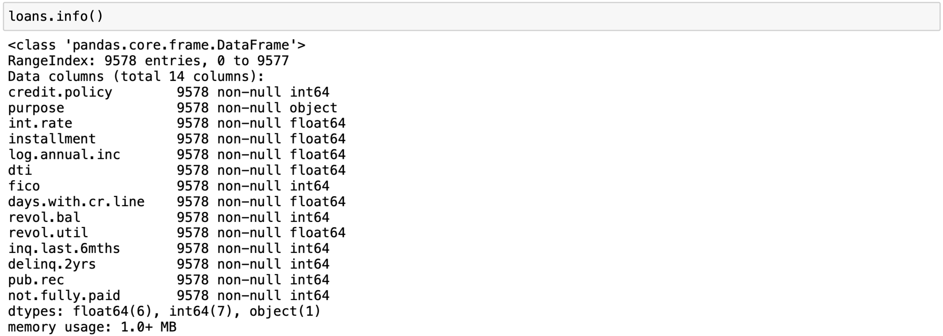
Setting up the Data:
Notes:
to transform them using dummy variables so Sci-kit will be able to understand them.

Slide 9
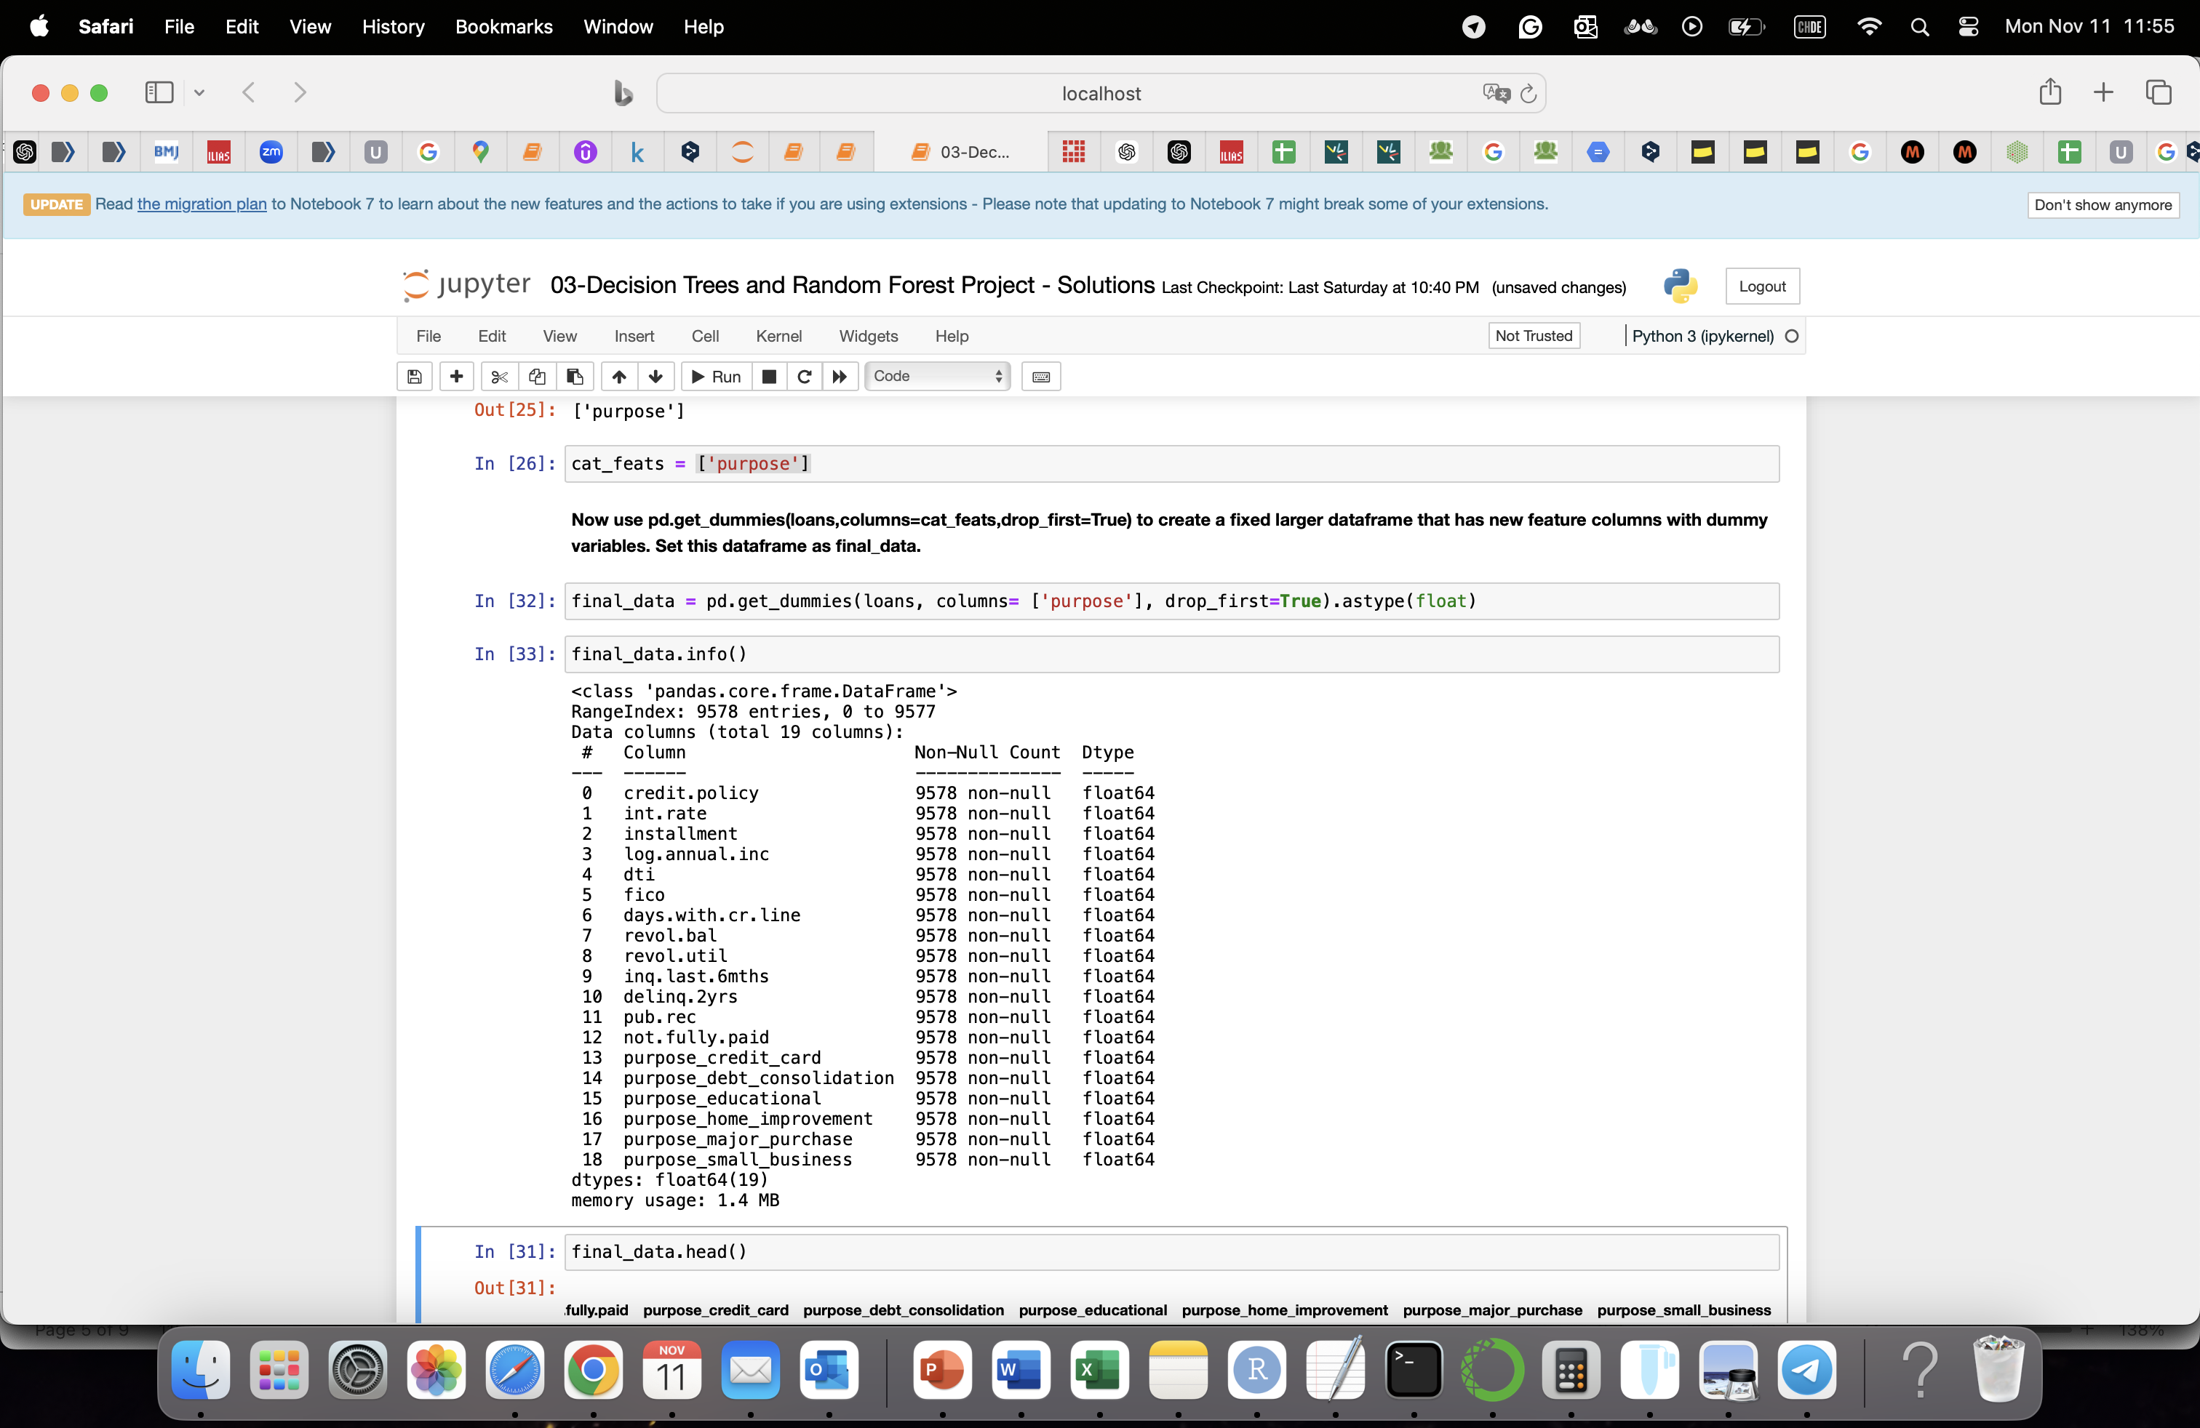
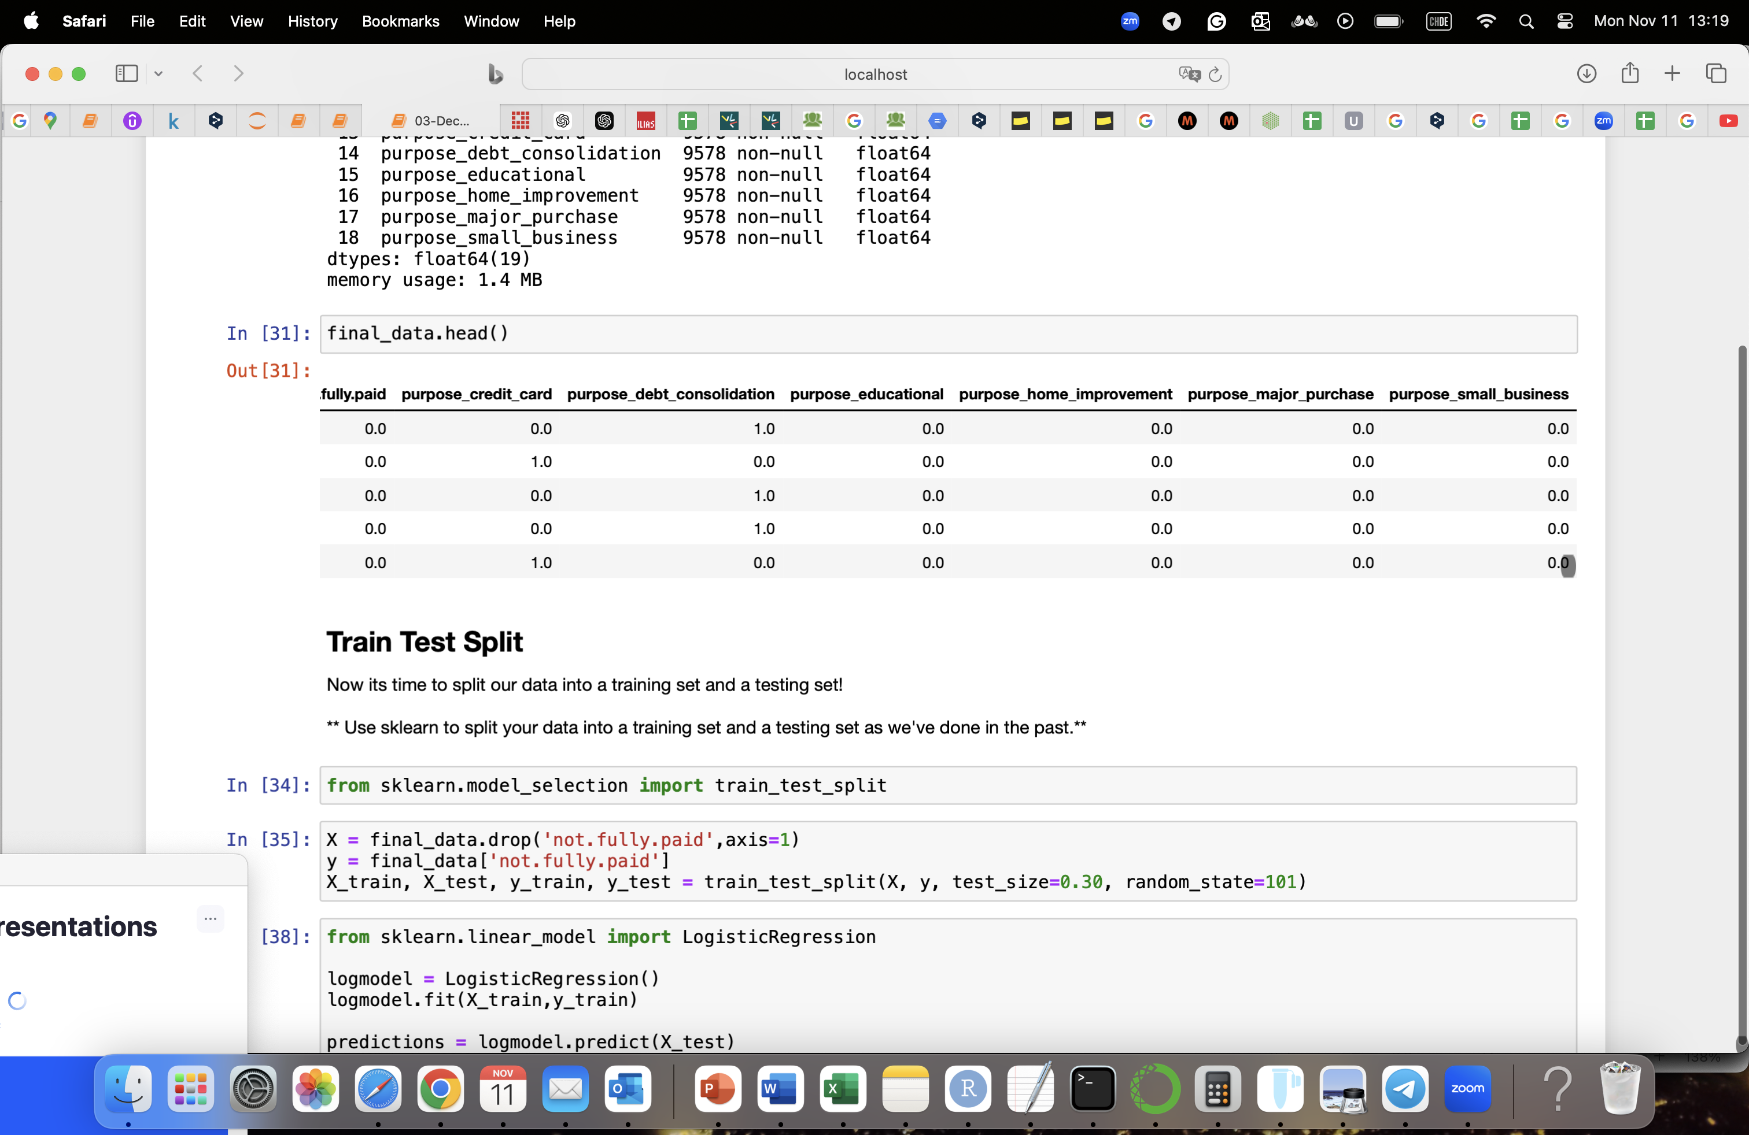
Setting up the Data:

Slide 10
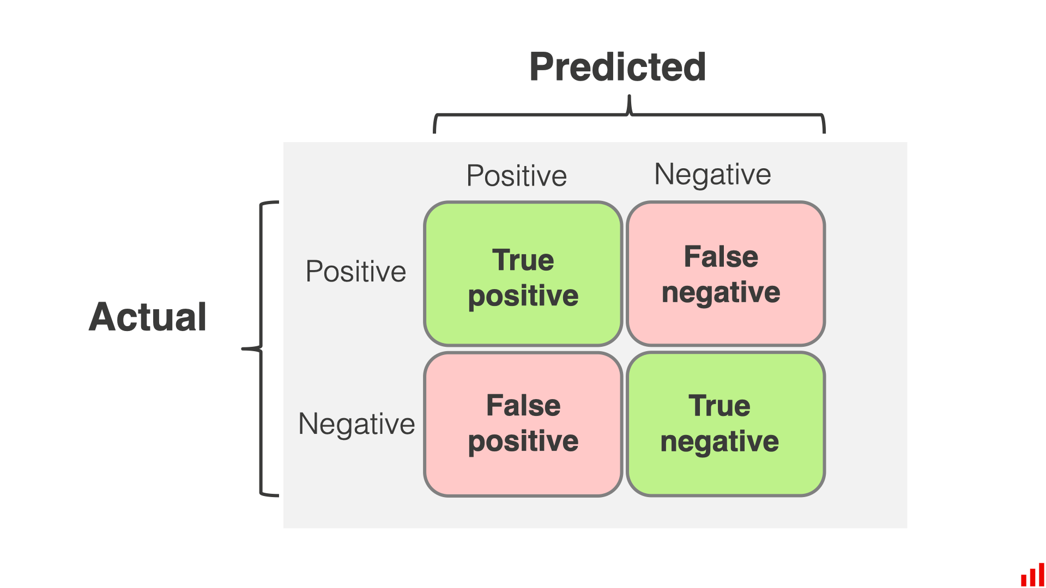
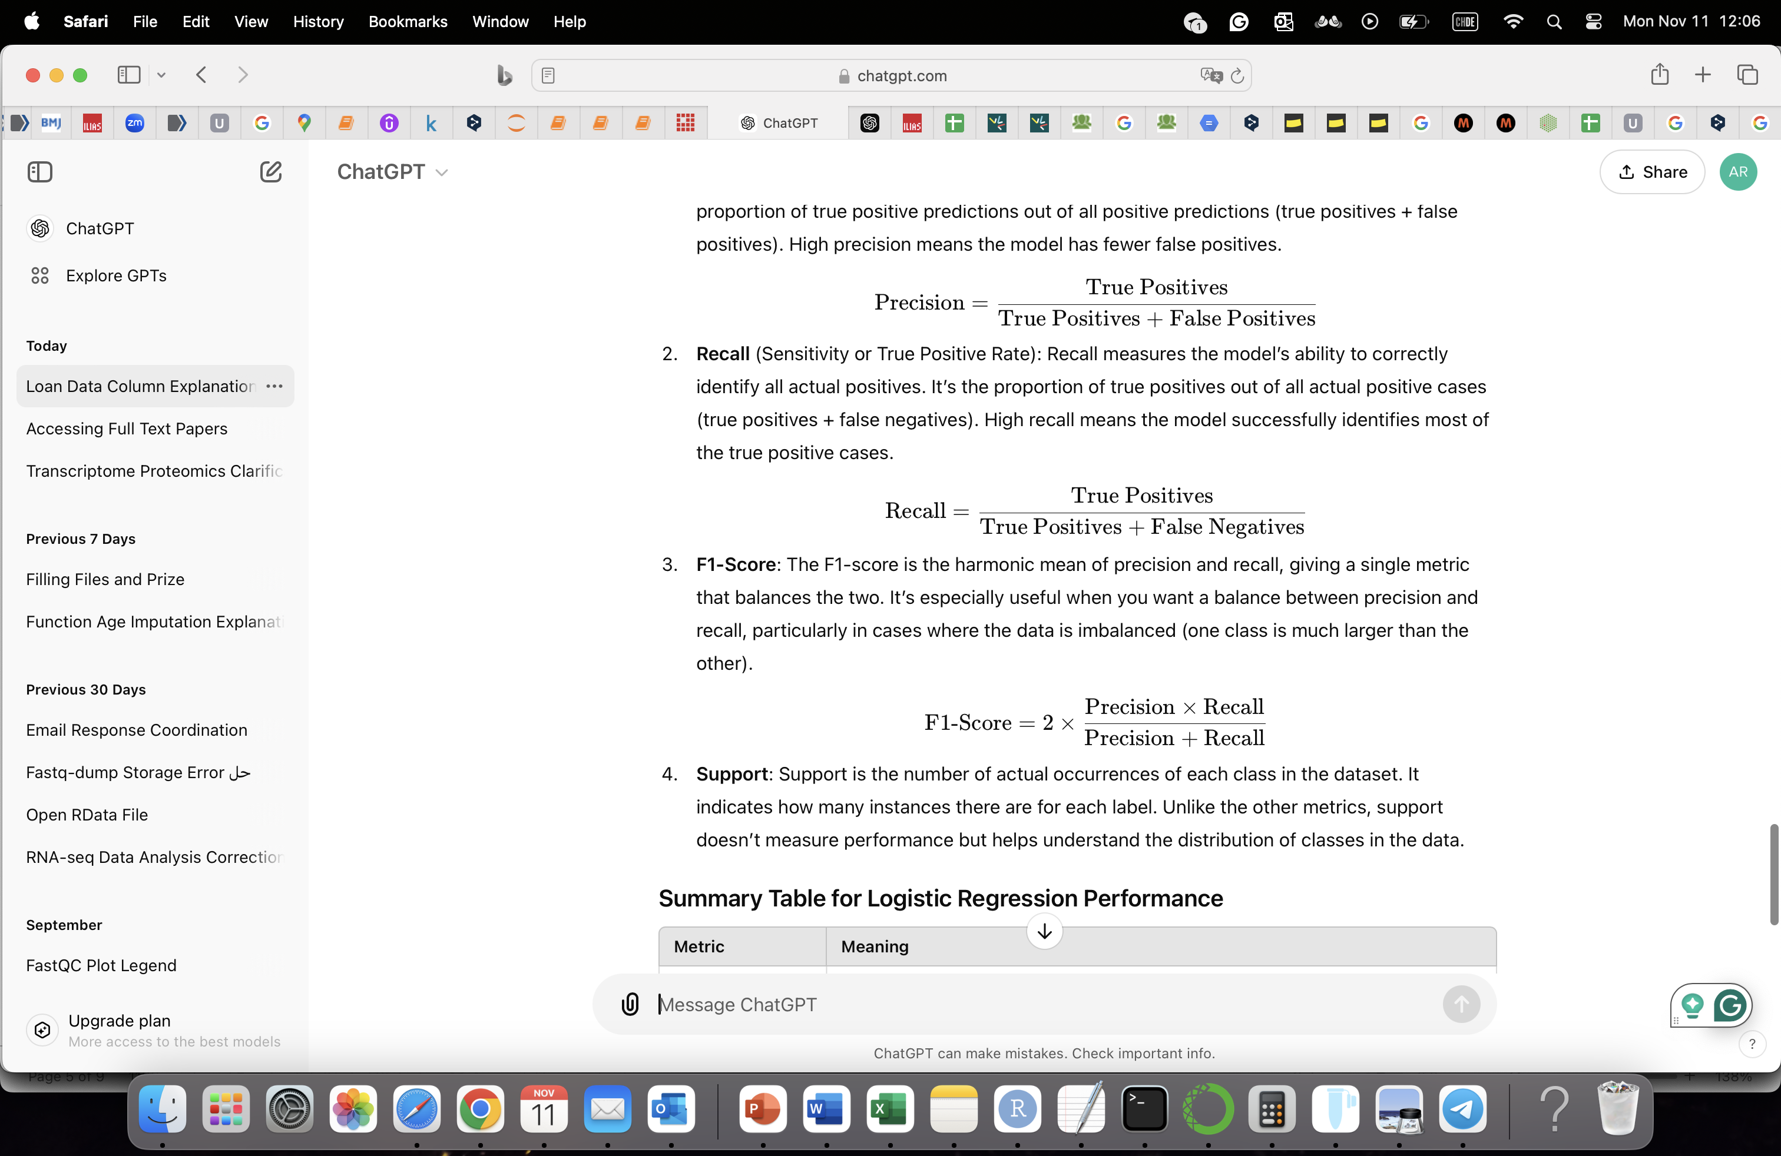
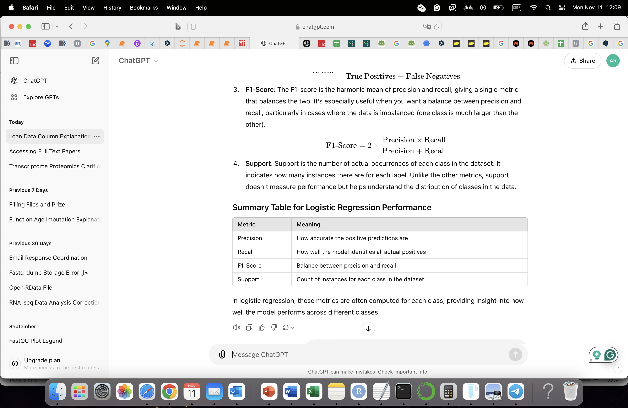
Logistic Regression Theory
Purpose: Classification
Evaluation matrices:
Accuracy: (TP + TN) / total
Misclassification rate: (FP + FN) / total
Support is the actual count of each class, it doesn't change based on model predictions. Instead, it helps you interpret the precision, recall, and F1-score by showing how balanced or imbalanced the dataset is.

Slide 11
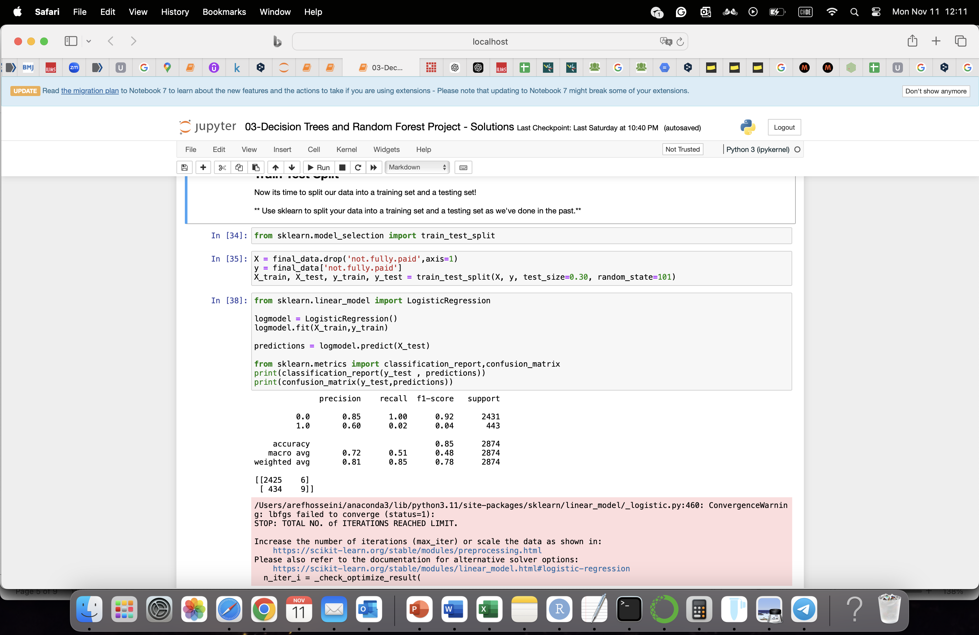
Train Test Split, Training, and evaluation

Slide 12
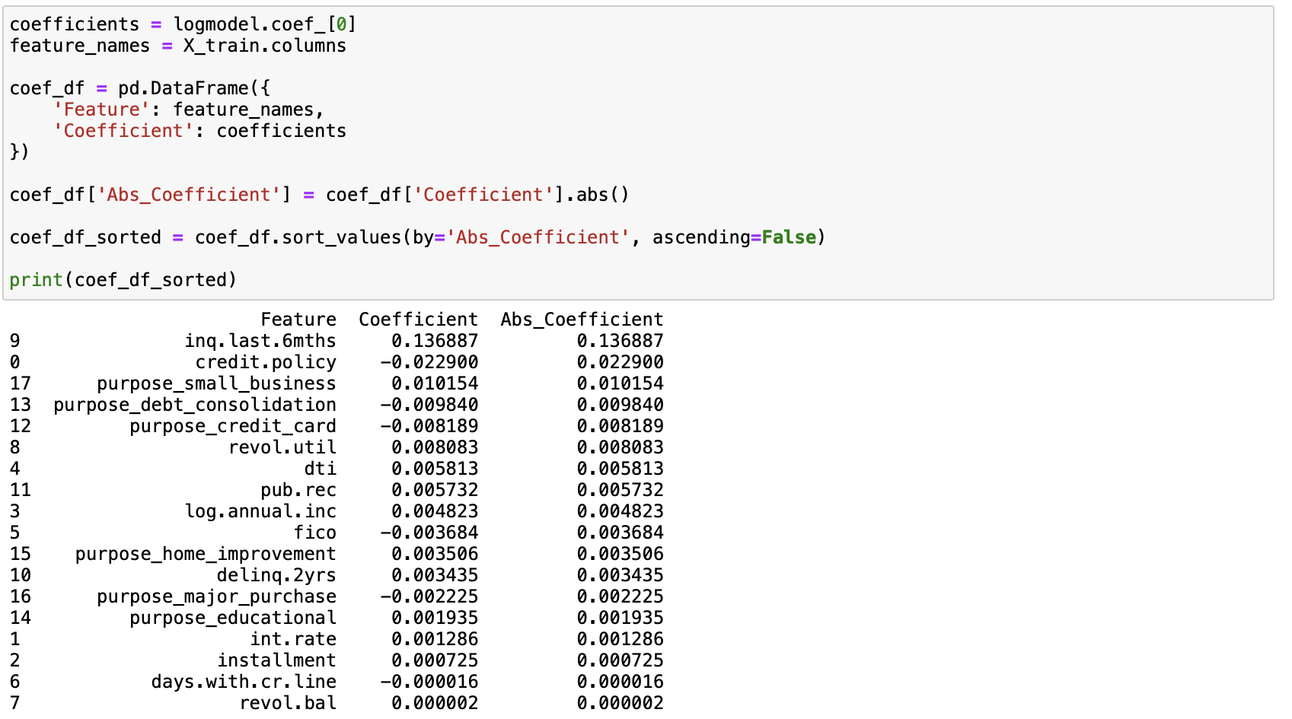
Identify the Most Important Feature
Notes:
inq.last.6mths: The number of times creditors have checked the borrower’s credit in the last 6 months (often happens when they apply for new credit).

Slide 13
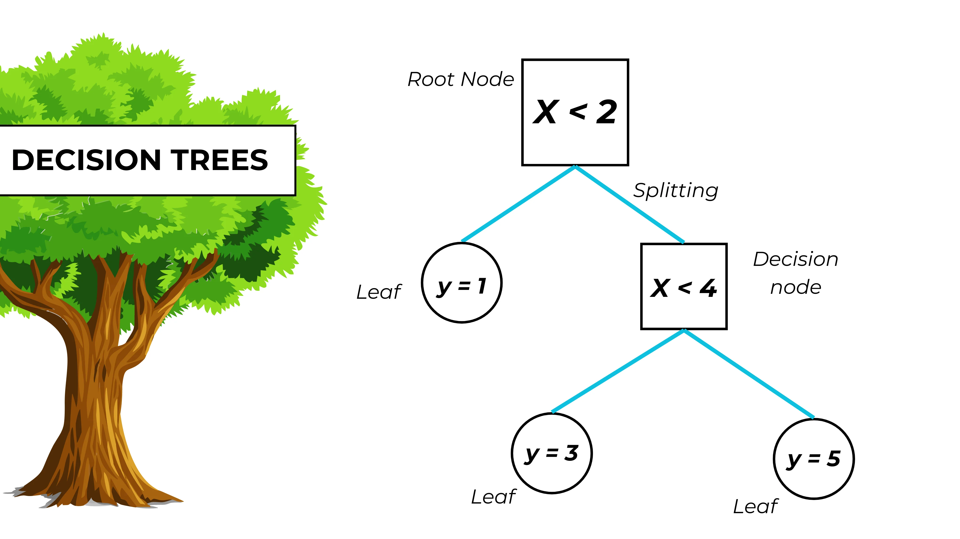
Decision Tree:
To predict the outcome (by classification algorithm) based on the input. Is a supervised learning algorithms!
Note that some features are more important than others! Some features could be even noise!
Nodes: represent one feature (input)
Edges: The outcome of the split to the next node
Root Node: the feature that performs the first split
Leaves: The final nodes that represent the outcome.
The main weakness of the decision tree is high variance:
Different combination of features leads to different outputs. It could also lead to overfitting.

Slide 14
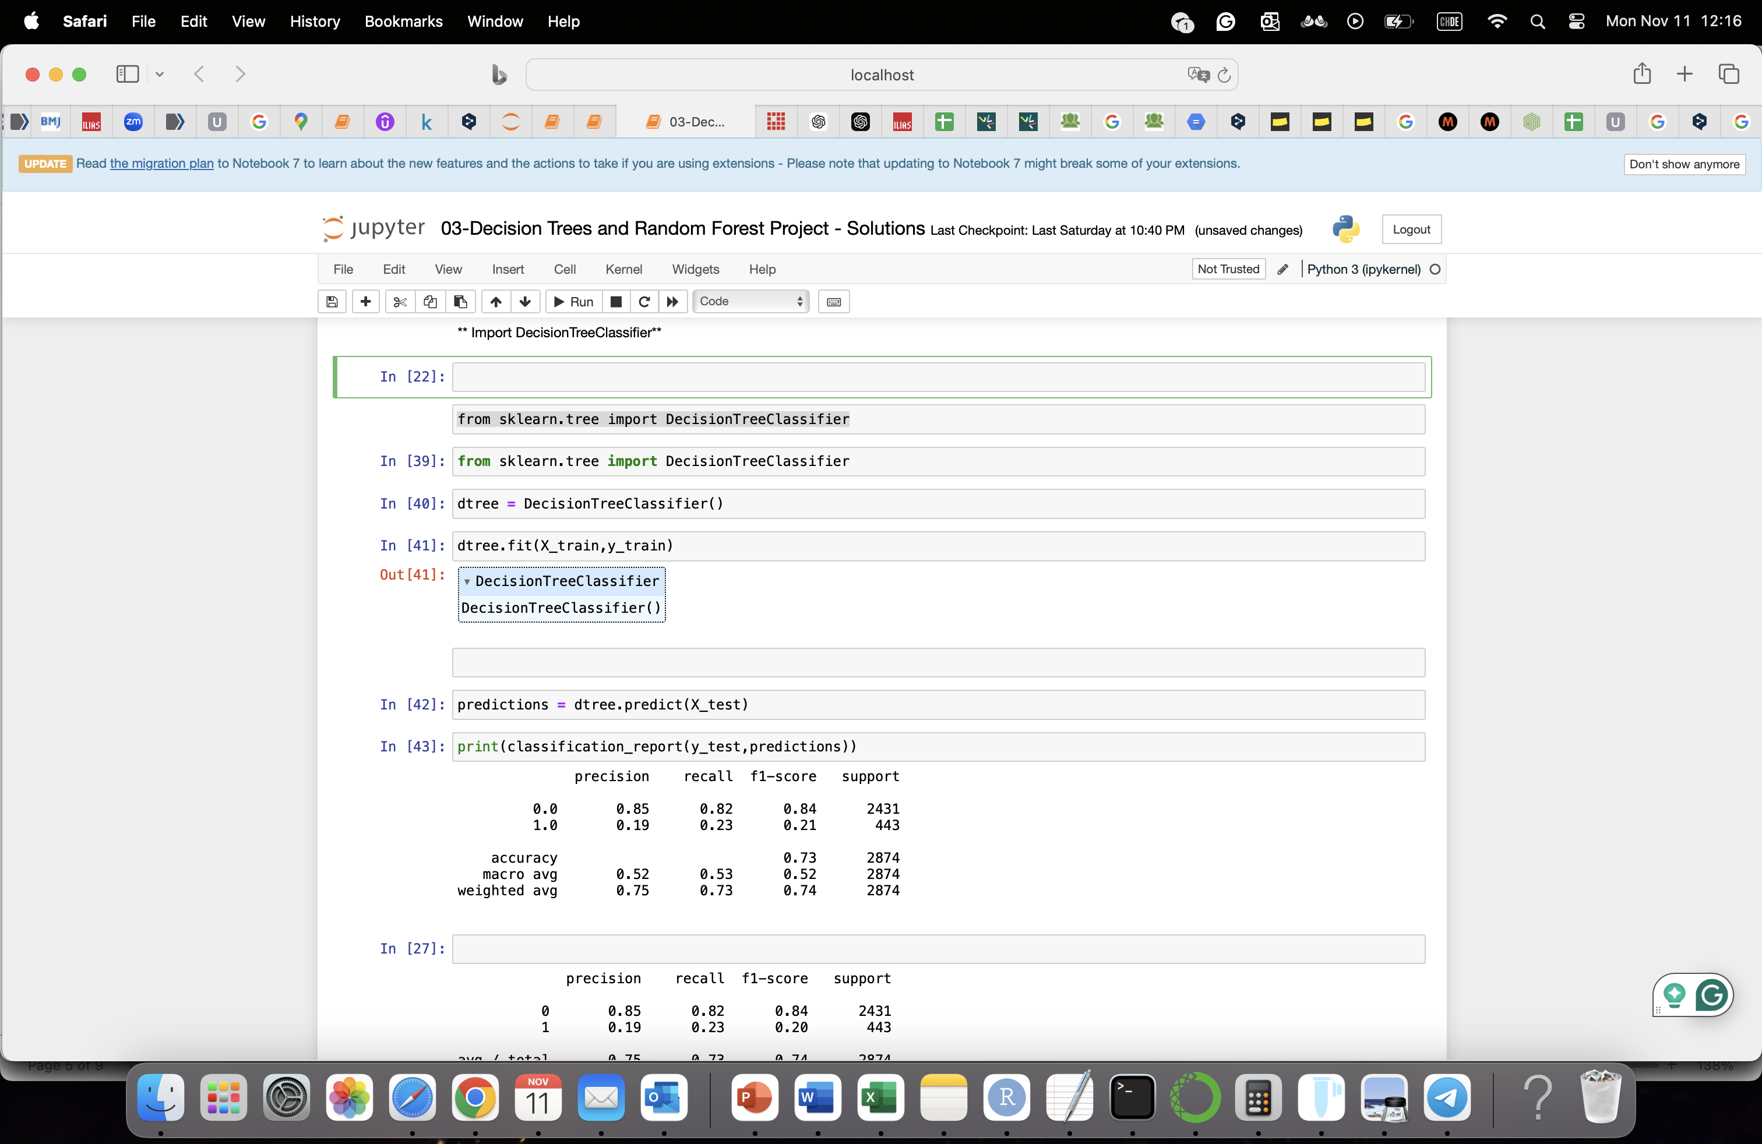
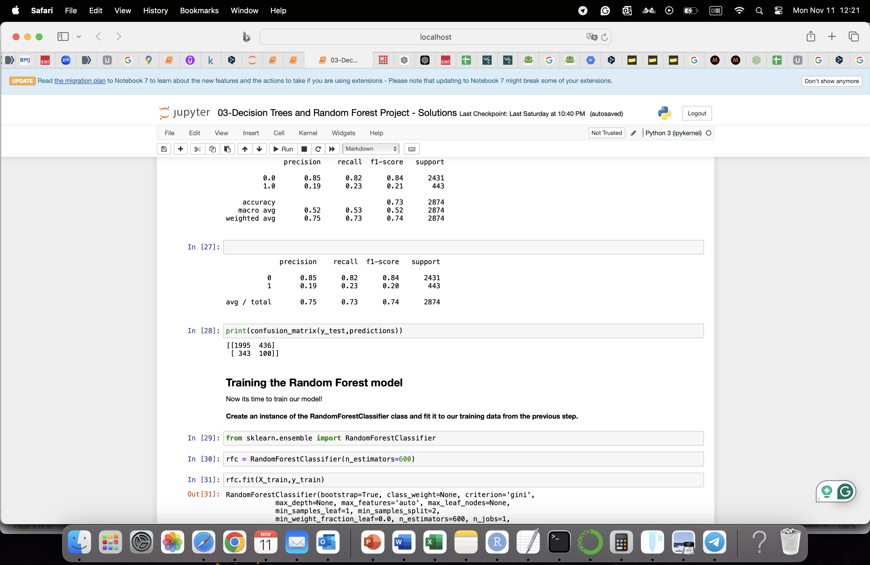
Training, and evaluation

Slide 15
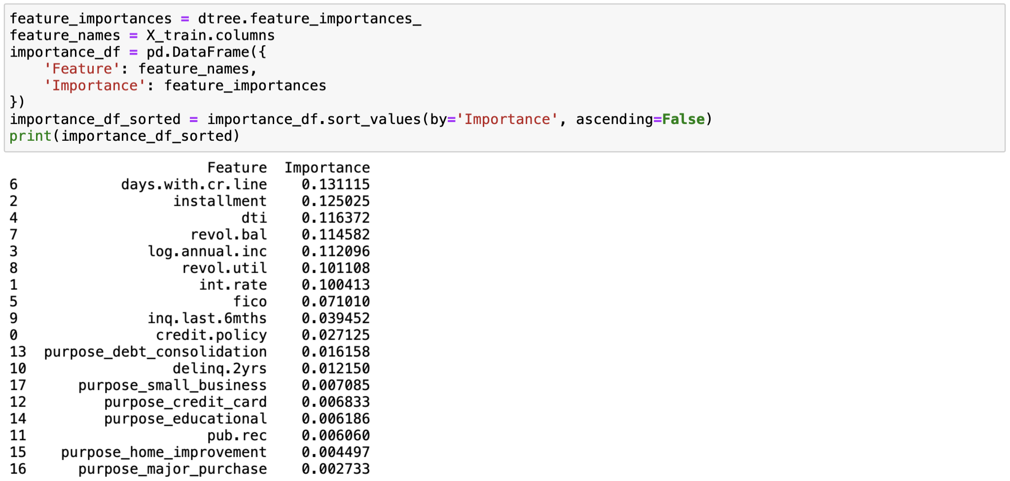
Identify the Most Important Feature
Notes:
days.with.cr.line: How long (in days) the borrower has had access to credit (credit card, line of credit, etc.).
installment: The monthly amount the borrower needs to pay back if they get the loan.
dti: Stands for "debt-to-income ratio." This is the borrower’s debt divided by their annual income, indicating how much of their income goes toward paying debts.

Slide 16
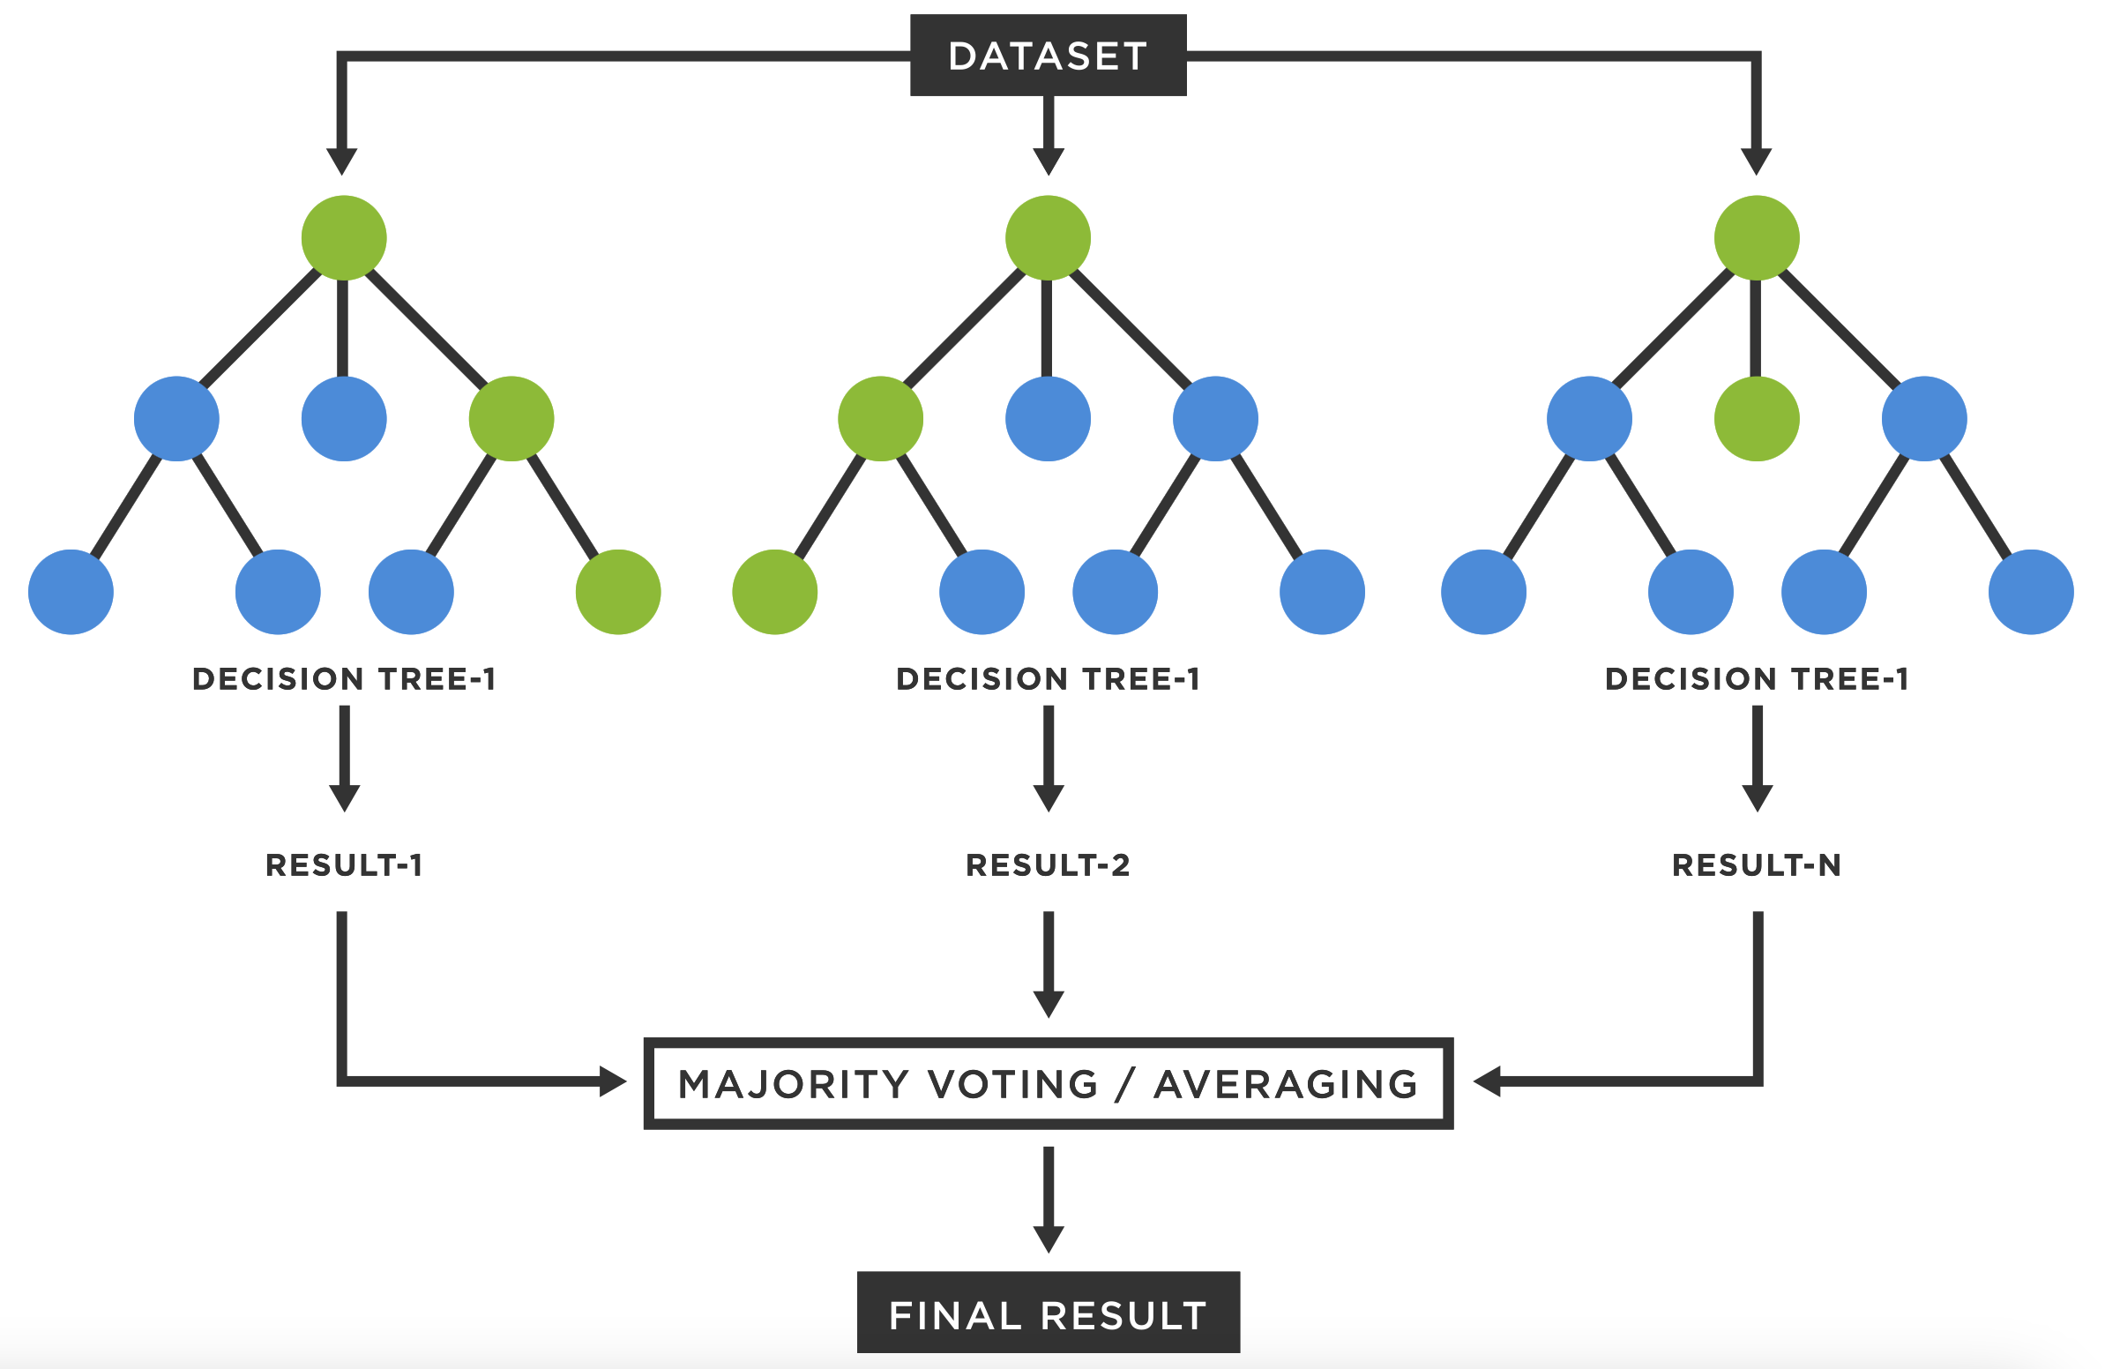
Ensemble learning methods are made up of a set of classifiers—e.g. decision trees—and their predictions are aggregated to identify the most popular result.
To overcome the main weakness of the decision tree.
Bagging: is the most well-known ensemble method, also known as bootstrap aggregation, and boosting.
Procedure:
A random sample of data in a training set is selected (individual data points can be chosen more than once).
These models are then trained independently.
The average or majority of those predictions yield a more accurate estimate (Less variance).
Random Forest: is an extension of the bagging method!

Slide 17
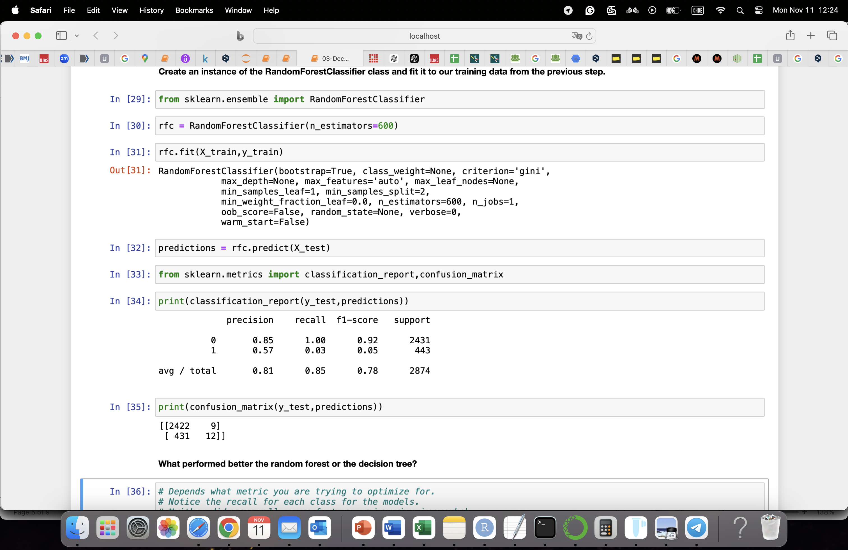
Training, and evaluation

